Slide 1
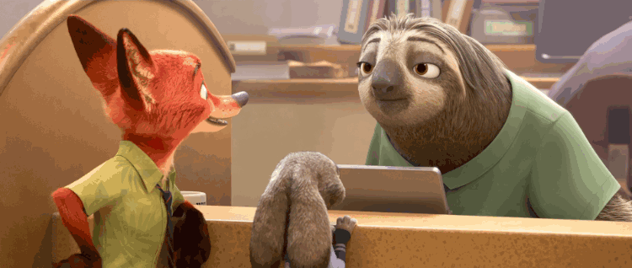
Are you Flash?
Yes, I am.

Slide 2
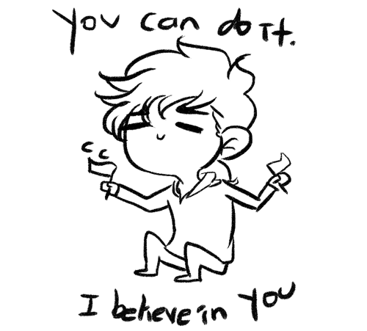

Slide 3
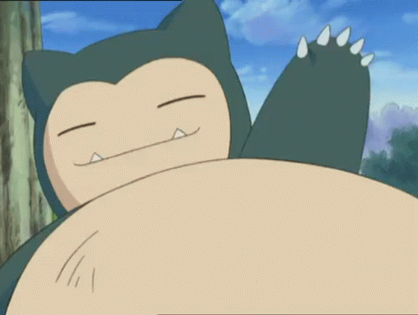
【第三週英語作業】
1.聆聽和跟讀英語 CD1 20~23首
2.完成習作P43~P44。

Slide 4
Let’s meet the opposite words!

Slide 6
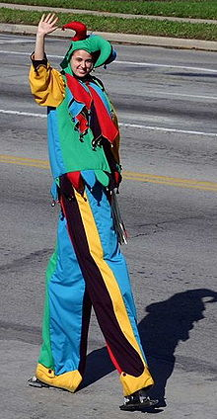
tall

Slide 7
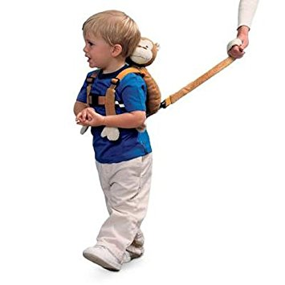
short

Slide 8
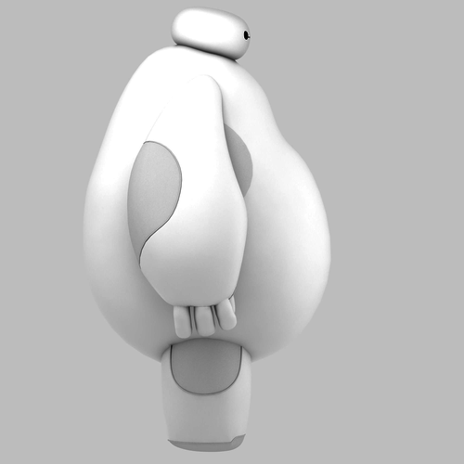
fat

Slide 9
thin

Slide 10
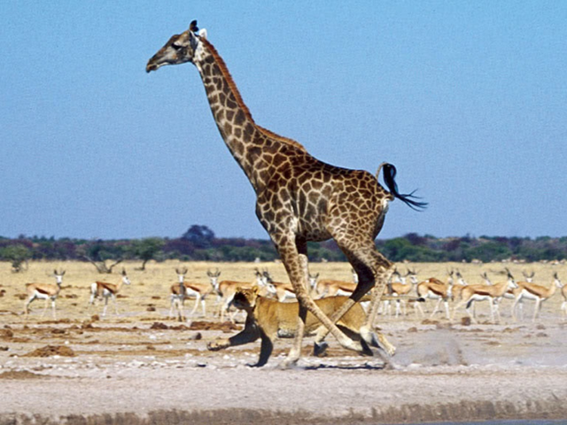
I’m tall.
I’m short.

Slide 11
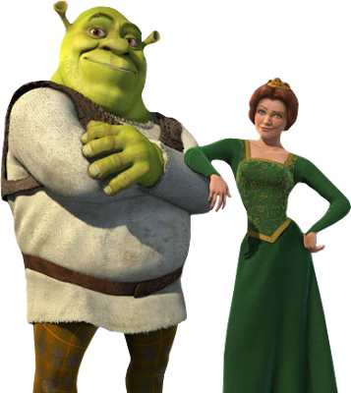
I’m fat.
I’m thin.

Slide 12
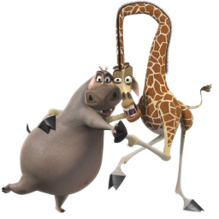
I’m tall and thin.
I’m fat and short.

Slide 13
Are you _______?
Yes, I am.
No, I’m not.

